Slide 1
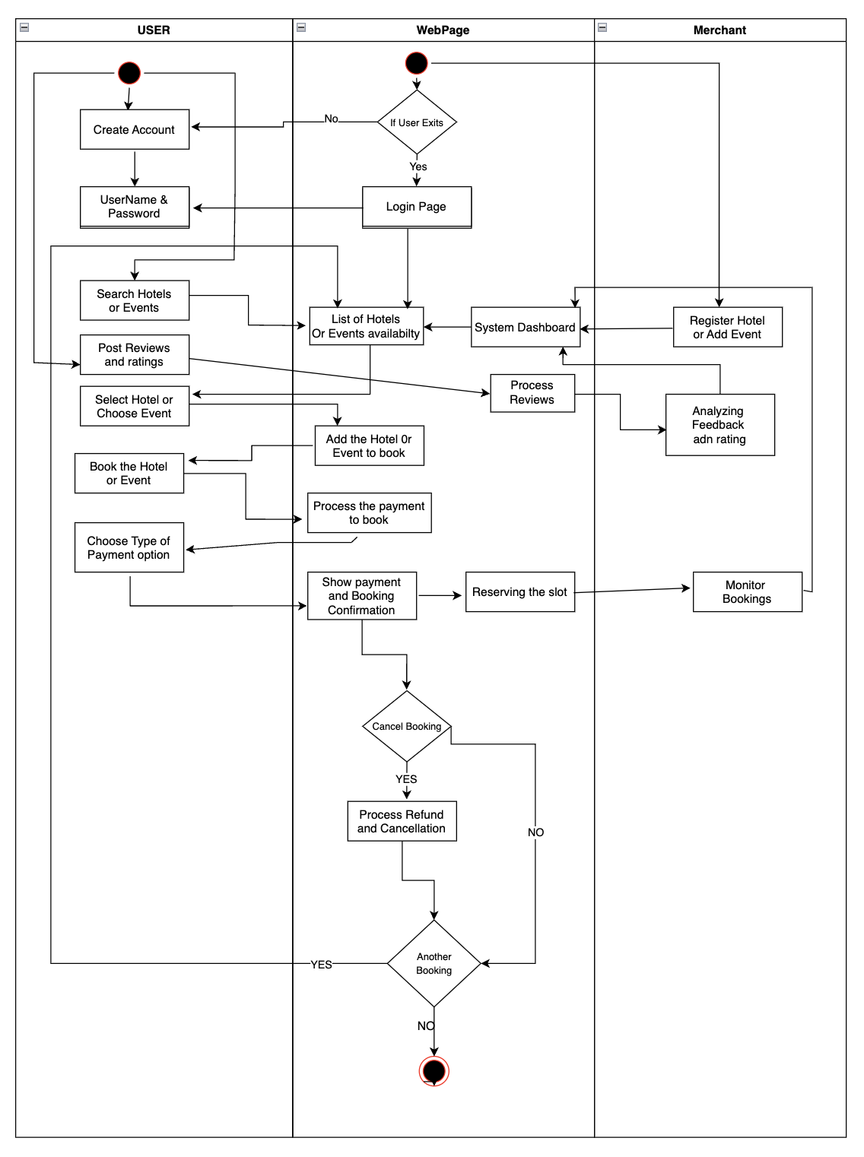
Reviewer Activity Diagram

